Slide 1
Word Meaning and Similarity
Word Similarity: Distributional Similarity (I)

Slide 2
Problems with thesaurus-based meaning
We don’t have a thesaurus for every language
Even if we do, they have problems with recall
Many words are missing
Most (if not all) phrases are missing
Some connections between senses are missing
Thesauri work less well for verbs, adjectives
Adjectives and verbs have less structured hyponymy relations

Slide 3
Distributional models of meaning
Also called vector-space models of meaning
Offer much higher recall than hand-built thesauri
Although they tend to have lower precision
Also called vector-space models of meaning
Offer much higher recall than hand-built thesauri
Although they tend to have lower precision
Zellig Harris (1954): “oculist and eye-doctor … occur in almost the same environments…. If A and B have almost identical environments we say that they are synonyms.
Firth (1957): “You shall know a word by the company it keeps!”

Slide 4
Intuition of distributional word similarity
Nida example:
A bottle of tesgüino is on the table
Everybody likes tesgüino
Tesgüino makes you drunk
We make tesgüino out of corn.
From context words humans can guess tesgüino means
an alcoholic beverage like beer
Intuition for algorithm:
Two words are similar if they have similar word contexts.

Slide 5
Reminder: Term-document matrix
Each cell: count of term t in a document d: tf_{t,d}:
Each document is a count vector in ℕ^{v}: a column below

Slide 6
Reminder: Term-document matrix
Two documents are similar if their vectors are similar

Slide 7
The words in a term-document matrix
Each word is a count vector in ℕ^{D}: a row below

Slide 8
The words in a term-document matrix
Two words are similar if their vectors are similar

Slide 9
The Term-Context matrix
Instead of using entire documents, use smaller contexts
Paragraph
Window of 10 words
A word is now defined by a vector over counts of context words

Slide 10
Sample contexts: 20 words (Brown corpus)
equal amount of sugar, a sliced lemon, a tablespoonful of apricot preserve or jam, a pinch each of clove and nutmeg,
on board for their enjoyment. Cautiously she sampled her first pineapple and another fruit whose taste she likened to that of
of a recursive type well suited to programming on the digital computer. In finding the optimal R-stage policy from that of
substantially affect commerce, for the purpose of gathering data and information necessary for the study authorized in the first section of this

Slide 11
Term-context matrix for word similarity
Two words are similar in meaning if their context vectors are similar

Slide 12
Should we use raw counts?
For the term-document matrix
We used tf-idf instead of raw term counts
For the term-context matrix
Positive Pointwise Mutual Information (PPMI) is common

Slide 13
Pointwise Mutual Information
Pointwise mutual information:
Do events x and y co-occur more than if they were independent?
PMI between two words: (Church & Hanks 1989)
Do words x and y co-occur more than if they were independent?
Positive PMI between two words (Niwa & Nitta 1994)
Replace all PMI values less than 0 with zero

Slide 14
Computing PPMI on a term-context matrix
Matrix F with W rows (words) and C columns (contexts)
f_{ij} is # of times w_{i} occurs in context c_{j}

Slide 15
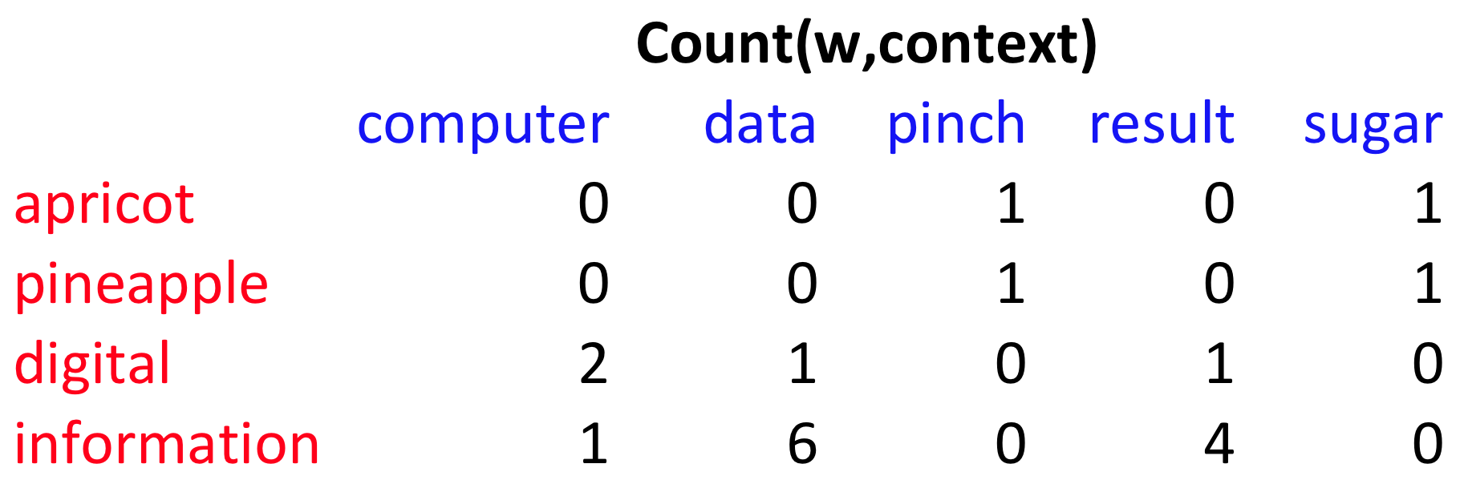
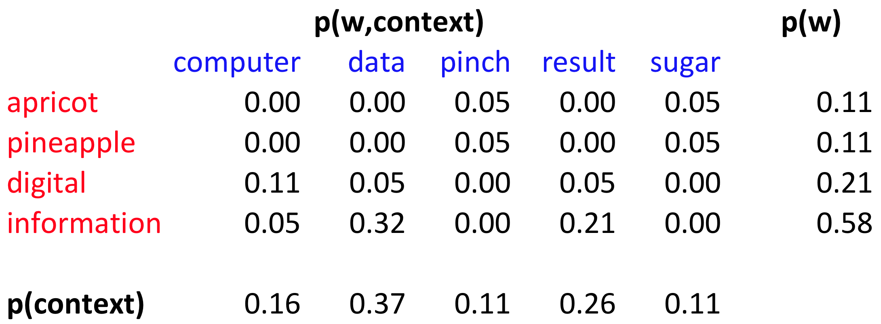
p(w=information,c=data) =
p(w=information) =
p(c=data) =
6/19
= .32
11/19
= .58
7/19
= .37

Slide 16
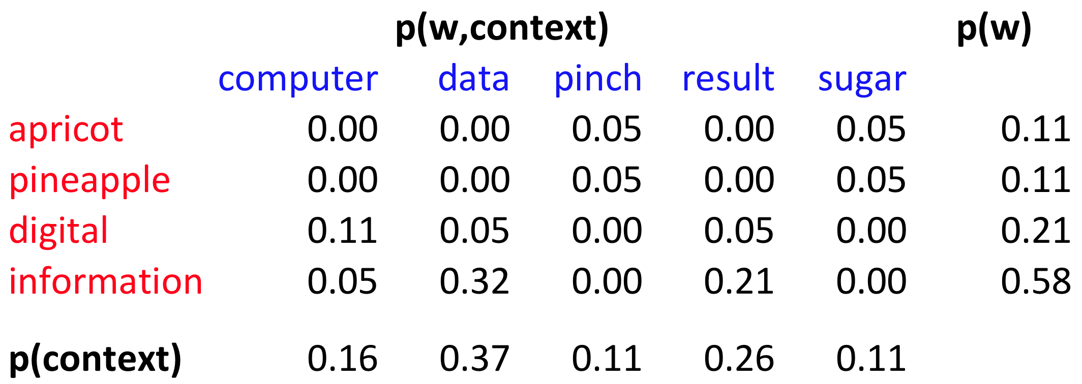
pmi(information,data) = log₂ (
.32 /
(.37*.58) )
= .58
(.57 using full precision)

Slide 17
Weighing PMI
PMI is biased toward infrequent events
Various weighting schemes help alleviate this
See Turney and Pantel (2010)
Add-one smoothing can also help

Slide 20
Word Meaning and Similarity
Word Similarity: Distributional Similarity (I)

